Slide 1
Anatomical Position

Slide 2
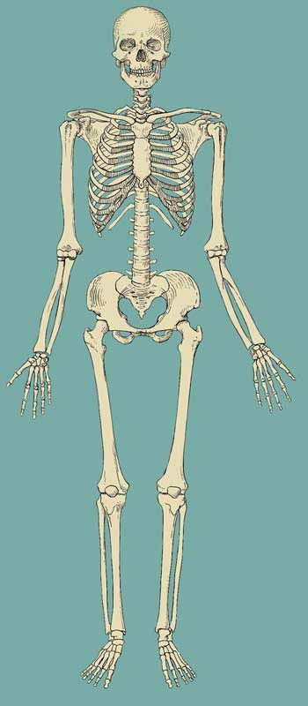
What is it?
The anatomical position is:
“the universal accepted starting point used to describe or analyze anatomical terms or movement.”
To be in correct anatomical position, the body must meet 3 criteria:
Upright, standing position
Face and feet pointing forward
Arms at the side, palms facing forward
But how do we use the anatomical position to describe direction and planes?

Slide 3
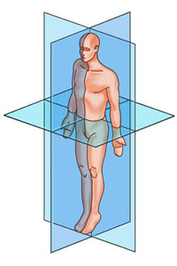
Anatomical Planes
-relate to positions in space and found at right angles to each other
-these planes can be positioned on specific parts of the body
Frontal(Coronal)
-vertical; splits the body into front and back halves

Slide 4
Anatomical Planes
-relate to positions in space and found at right angles to each other
-these planes can be positioned on specific parts of the body
Sagittal
-vertical; splits the body into left and right halves

Slide 5
Anatomical Planes
-relate to positions in space and found at right angles to each other
-these planes can be positioned on specific parts of the body
Transverse
-horizontal; splits the body into upper and lower halves

Slide 6
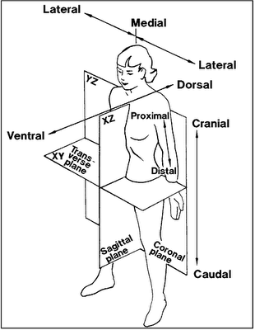
Body Position Terminology
The following terms will become like a second language for you. These terms are used to describe position of the body and will be used extensively when we talk about muscles and bones
Medial- towards the midline(center) of the body
Lateral- away from the midline of the body
Superficial - on or close to the surface of the body
Deep - farther away from the surface of the body

Slide 7
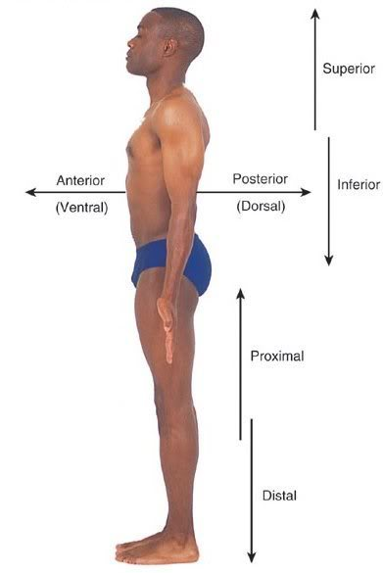
Superior- towards the top of the body (cranial)
Inferior- towards the bottom of the body (caudal)
Anterior- towards the front of the body (ventral)
Posterior- towards the back of the body (dorsal)
Proximal- situated closest to the point of attachment
Distal- situated farthest from the point of attachment

